Slide 1
Anigame Plus
By: Alyssa Pollard, Dominic Baker,& Rickey Prewitt

Slide 2
BrainStorming
We conducted hybrid meeting and came with two ideas each totaling to six ideas.
We created a wheel generator and spun it three times the top three ideas were laptops, video games, and anime.
We combined anime and video games because we could not choice one.
We had no issues due to previous interactions and projects we have done together.

Slide 3
What is our Idea?
Who is it for ?
Why?
To allow users to search where to buy games, consoles, and watch certain anime shows.
Our targeted audience is gamers and anime watchers they tend to go hand and hand
We created this idea to help cut down the time searching for these items

Slide 4
Anticipated Challenges
Migrating the API
Learning how to implement extensions
Geographic locations
Cookies
Manually creating search features if API is absent
Subscription issues

Slide 5
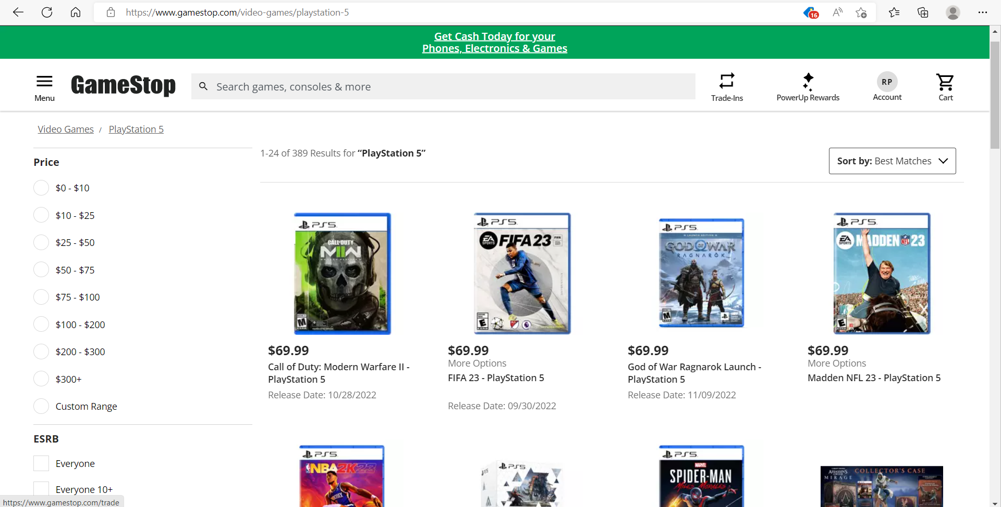
Sample Story
The user go to firefox Mozilla web browser add the extension and then look up PlayStation 5 prices and if it’s used or old. It will be able to pull up searches from GameStop and Best Buy.

Slide 6
How do we plan to split the work
We plan on taking thee websites, GameStop, Best Buy and crunchyroll. Since we have a short amount of time we decided to stick with only three websites for each member.
We will keep our regular positions with
Alyssa as note taker and working on the crunchyroll site
Dominic as time tracker and working on GameStop site
Rickey as the final decision maker and working on the BestBuy site.

